Slide 1
Simulating Interviews through the Virtual and Two Dimensional Planes: A Comparison
CS 366: Advanced Projects in Interactive Media
Fall 2024
Karrington Wilson and Naomi Wang

Slide 2
Project Overview
CS 366: Advanced Projects in Interactive Media
Fall 2024
Description
Question
Starting with three individuals, we sought to compare the Body Swaps interview simulator on VR and 2D systems - this later expanded to our main study with 20 other Wellesley College students.
We hypothesized that the VR system, due to its immersive nature, would be able to reduce stress even further and better prepare candidates than 2D simulation would
When using an interview prep system, how do VR and 2D systems compare in effect on participants’ stress levels?

Slide 3
Goal & Motivation
CS 366: Advanced Projects in Interactive Media
Fall 2024
There is a growing interest in using VR as a tool for mental health and anxiety support, especially for social skills training and exposure therapy. VR interventions are praised for repeatability and other advantages, but at this stage, still have a high barrier in effectiveness and accessibility.
> Can VR offer effective interventions in mental health and career development?
We aim to compare how different levels of immersion - in our case 2D games versus VR - can improve Wellesley students’ interpersonal skills – training for interview preparation - as these skills are impacted by coalescent anxiety .

Slide 4
Methodology
DESIGN
COLLECT
ANALYZE
STUDY DESIGN
DATA COLLECTION
Within Subject
Both 2D (Macbook) and VR (Metaquest) used Body Swaps™
Participants randomly chosen to start with one system or the other
Participants answered 5 questions, the questions randomly chosen by system
Researchers in the room with participants
Body and eye contact trackers on the VR system and a voice tracker on both systems
Three questionnaires:
Pre-study questionnaire, Post-2D questionnaire, Post-VR questionnaire
Why?
Determine the participants' experience levels with VR, 2D platforms, and job interviews
Determine the participants’ stress levels before the study and after each simulation
Statistical analysis of quantitative data (e.g., paired sample T-tests) to compare stress levels between VR and 2D conditions.
Thematic analysis of qualitative data (based on questionnaires) to interpret trends and themes in the data and compare said data.
Notes:
S.T.A.R. Technique - situation, task, action, result → Storytelling meth

Slide 5


Live Demo
CS 366: Advanced Projects in Interactive Media
Fall 2024
2D Demo of how we formatted our study
VR Demo from Body Swaps Co.

Slide 6
Results
CS 366: Advanced Projects in Interactive Media
Fall 2024
Thematic Analysis
Participants did not note a significant difference on stress levels between the systems.
Around half of participants found the system they started with realistic (no statistical significance found in differences of means between VR and 2D), but most favored the VR system overall in terms of immersiveness and realistic scenarios
VR was rated higher in terms of feedback quality than 2D, possibly due to more trackers and better immersion. Participants favored the VR system as the preferred method for interview preparation
Overall, there were also comments about less comfort with the VR headset.

Slide 7
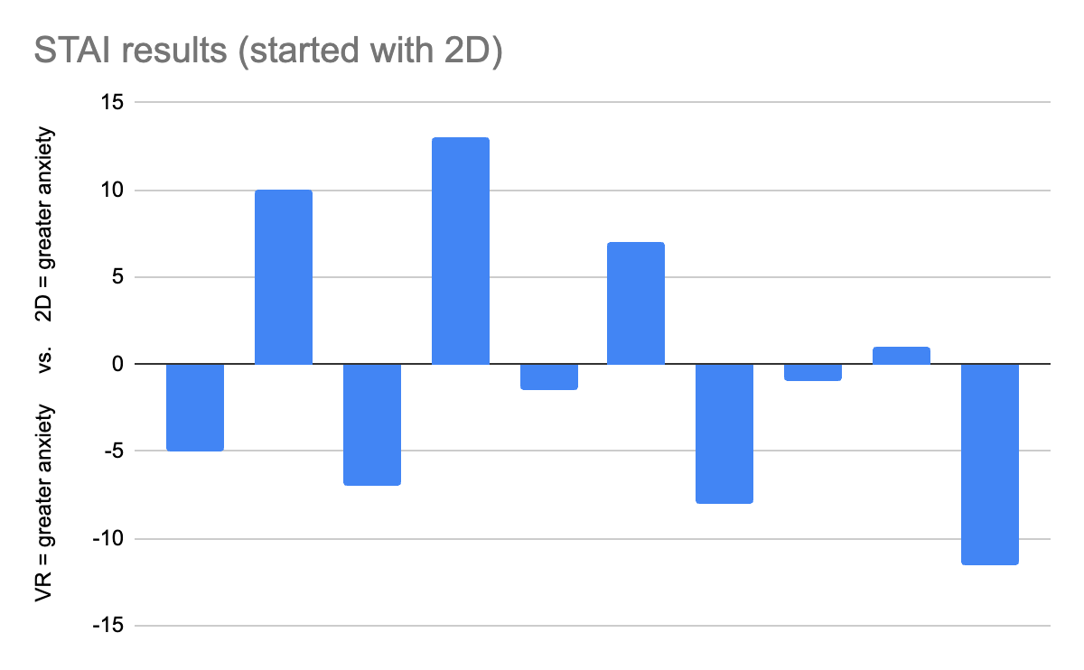
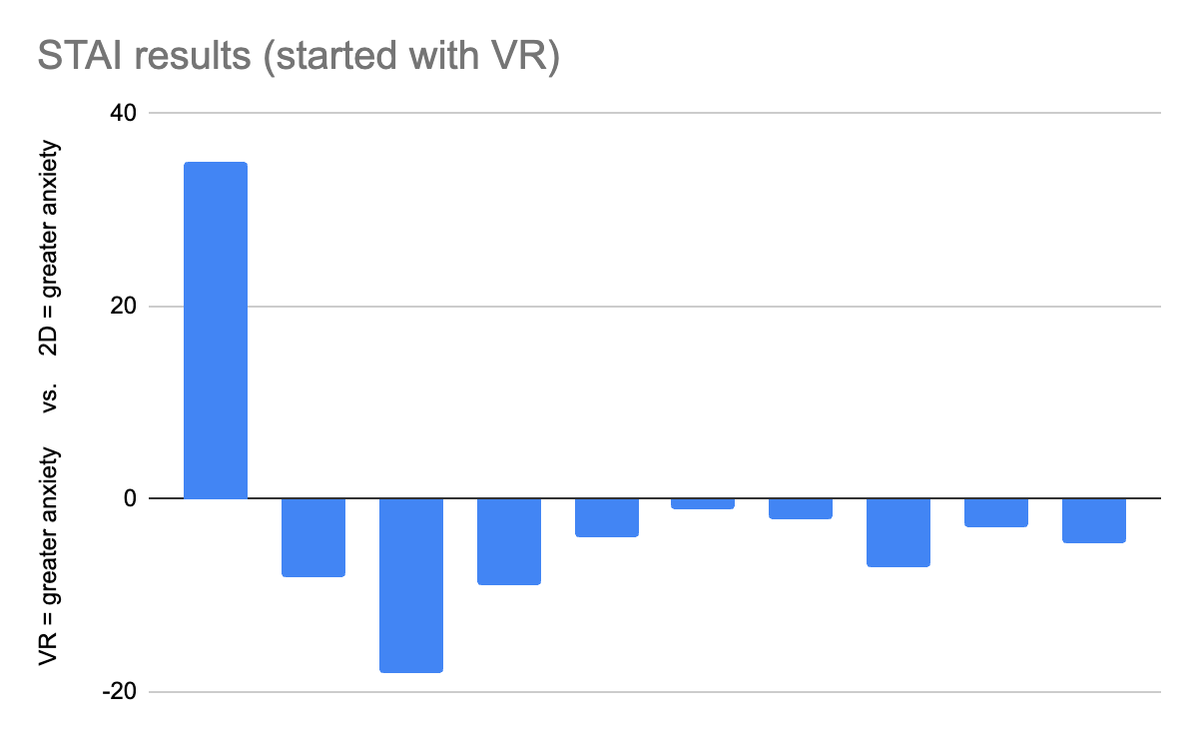
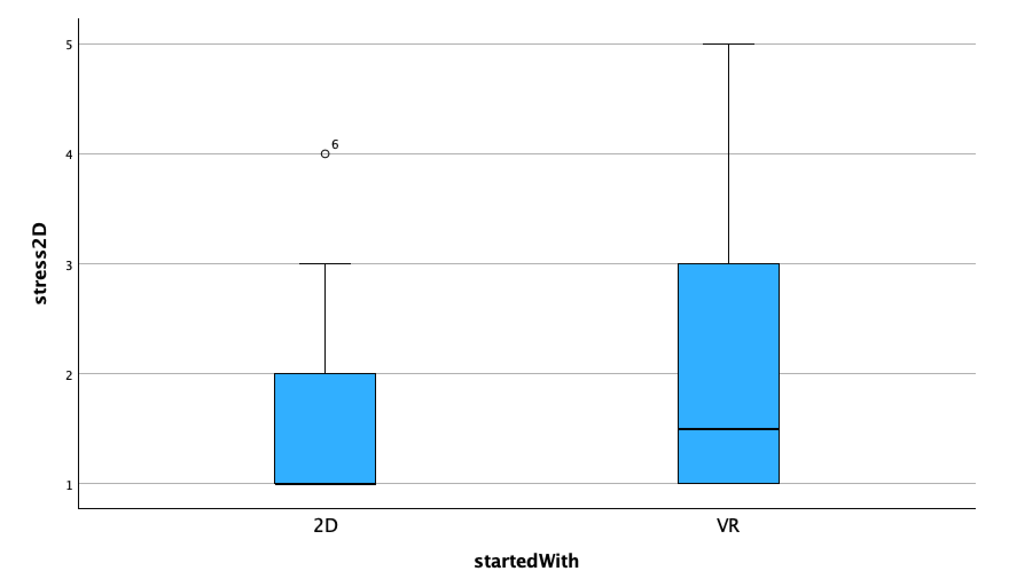
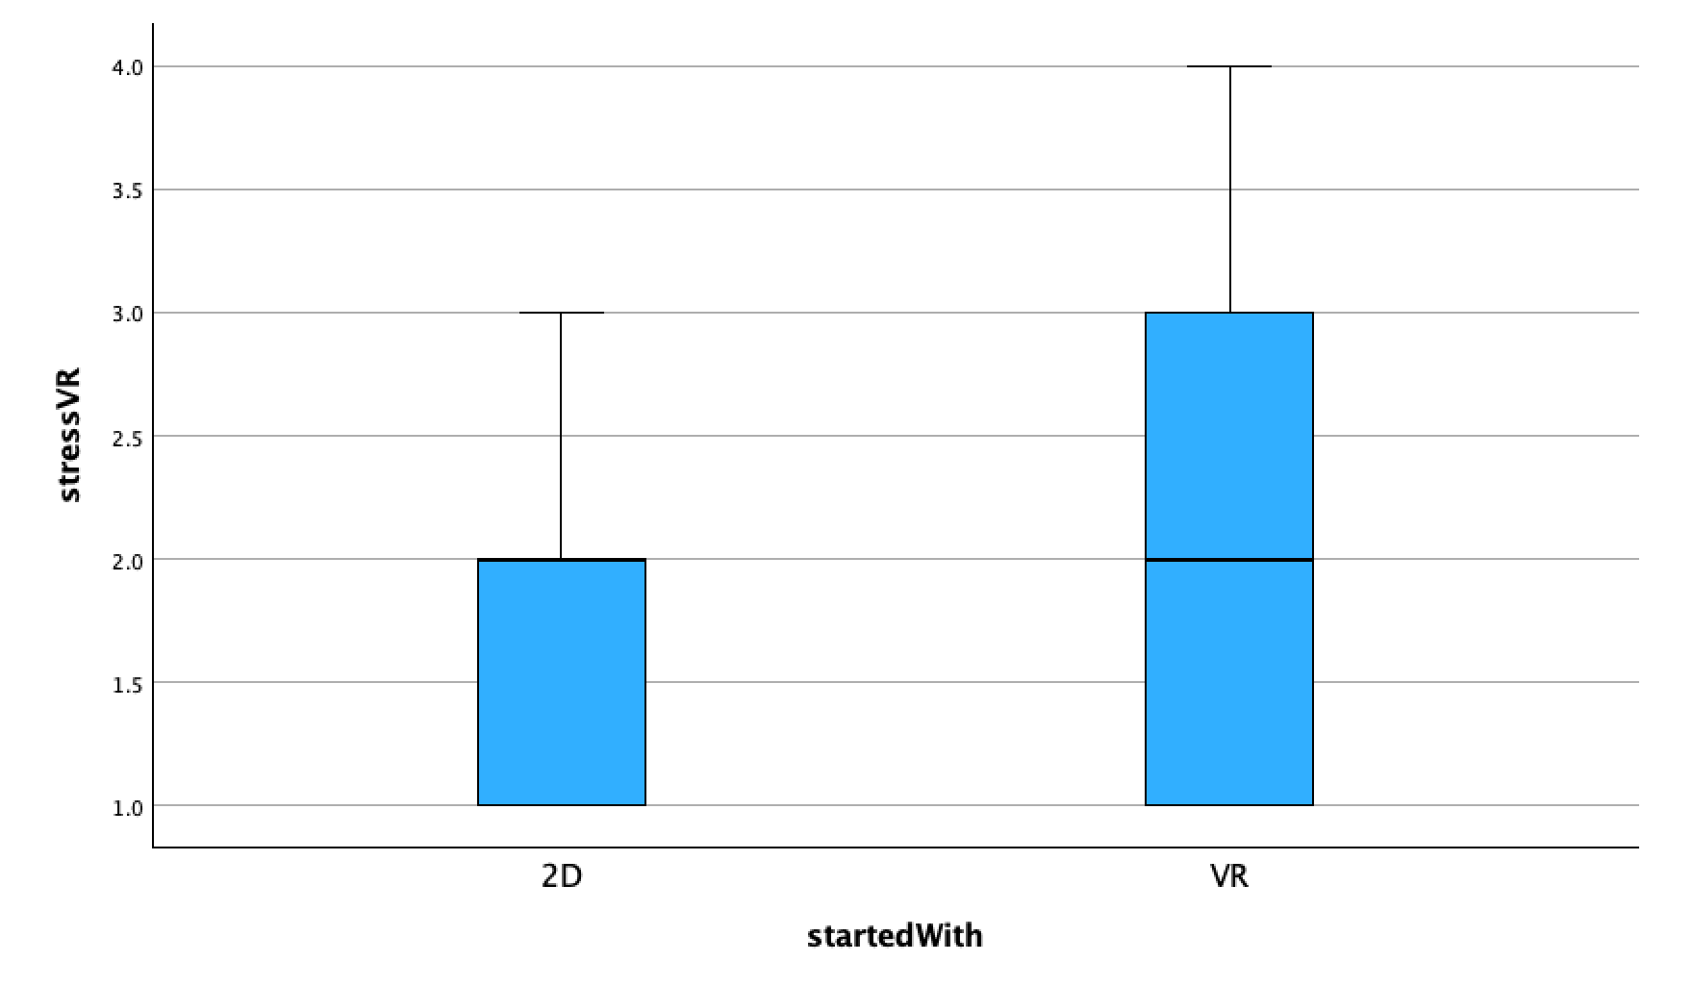
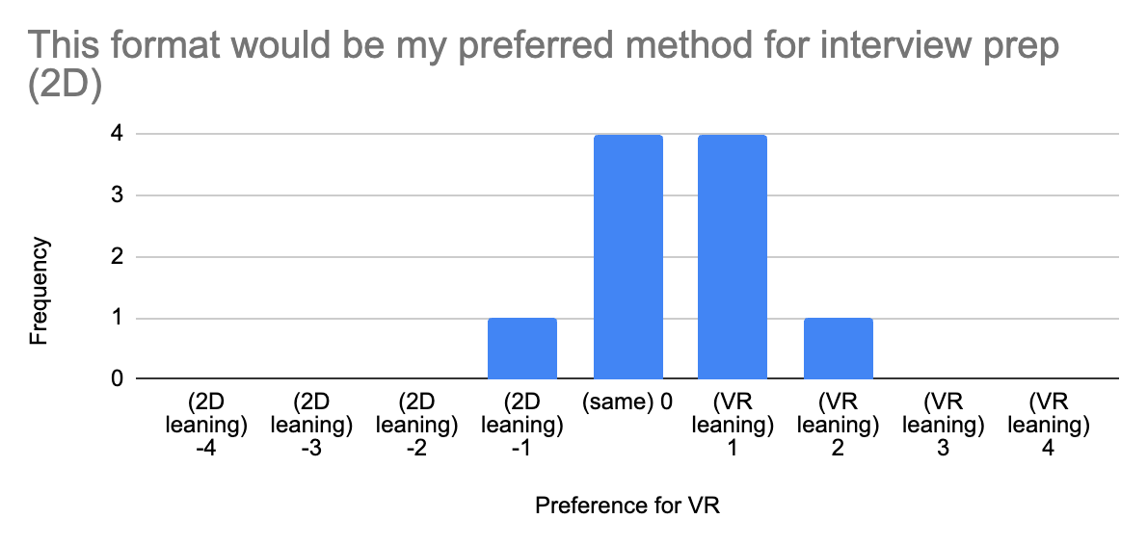
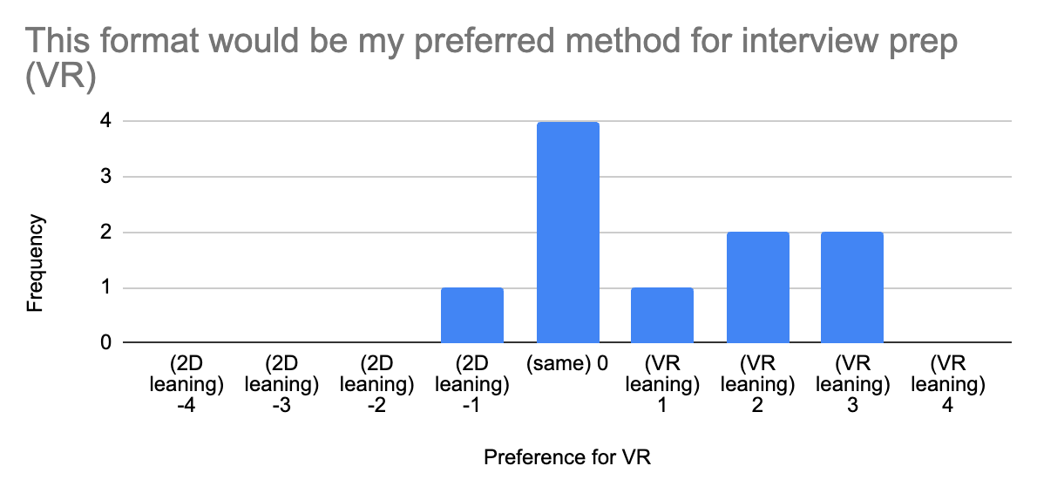
CS 366: Advanced Projects in Interactive Media
Fall 2024
(State-Trait Anxiety Inventory results) 2D-first have anxiety results that are even between 2D and VR formats. VR-first generally have less anxiety in the 2D format.
When contrasting 2D vs VR: Results showed that the mean was not statistically significantly different between the two groups (t = .330 w/ df=19, p = .745) at a significance level of 0.05.
Q: This was more stressful than an in-person interview.
Stress levels do not vary significantly between formats
(t = .142 w/ df=19, p =.888) at a significance level of 0.05
Statistical significance in difference between 2D and VR (t=-2.881 w/ df = 19, p=.01)

Slide 8
Contribution
CS 366: Advanced Projects in Interactive Media
Fall 2024
After simulations and in the questionnaires, participants found the simulator to be helpful and enjoyable. Statistical analysis mostly showed that there was no statistical significance in differences with questions regarding immersion, stress, and helpfulness.
But we found the VR better at perceived realism and feedback quality. Overall, the VR system seems to be more favored than the 2D gamified system.
Feedback also highlighted that more work needs to be done in developing the VR system for effectiveness and comfortability.

Slide 9
Thank you
CS 366: Advanced Projects in Interactive Media
Fall 2024
Q&A

